Slide 1



Noida Institute of Engineering and Technology, Greater Noida
Introduction to Digital Marketing
Unit: 1
DIGITAL MARKETING
Ms. Preeti Singh
MBA Department
B.Tech VI - Sem

Slide 2

Index/Content
S. No. | Index
1. | Name of Subject with code, Course and Subject Teacher
2. | Brief Introduction of Faculty member with Photograph
3. | Evaluation Scheme
4. | Syllabus
5. | Branch wise Application
6. | Course Objective(s)
7. | Course Outcome(s)
8. | Program Outcomes (POs)
9. | COs and POs Mapping

Slide 3
Index/Content
S. No. | Index
10. | Program Specific Outcomes (PSOs)
11. | Cos and PSOs Mapping
12. | Program Educational Objectives (PEOs)
13. | Result Analysis
14. | End Semester Question paper Templates
15. | Prequisite/Recap
16. | Brief Indtroduction about the Subject with Videos
17. | Unit Contents
18. | Unit Objectives
19. | Topic Objectives/Topic Outcome

Slide 4
Index/Content
S. No. | Index
20. | Lecture related to topic
21. | Daily Quiz
22. | Weekly Assignment
23. | Topic Links
24. | MCQs
25. | Glossary Questions
26. | Old question papers
27. | Expected Questions
28. | Recap of unit

Slide 5
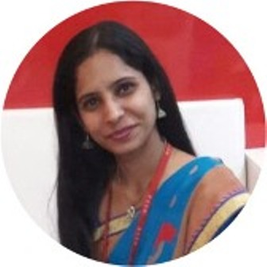
Faculty Profile
Ms. Preeti Singh
Assistant Professor
Department: Management Studies
Email ID: preeti.singh@niet.co.in
Qualification: BBA, MBA, M.Phil
Specialisation: HRM
Total Teaching Experience: 8+ years
Teaching Area: HR, Marketing, General Management

Slide 6
Evaluation scheme

Slide 7

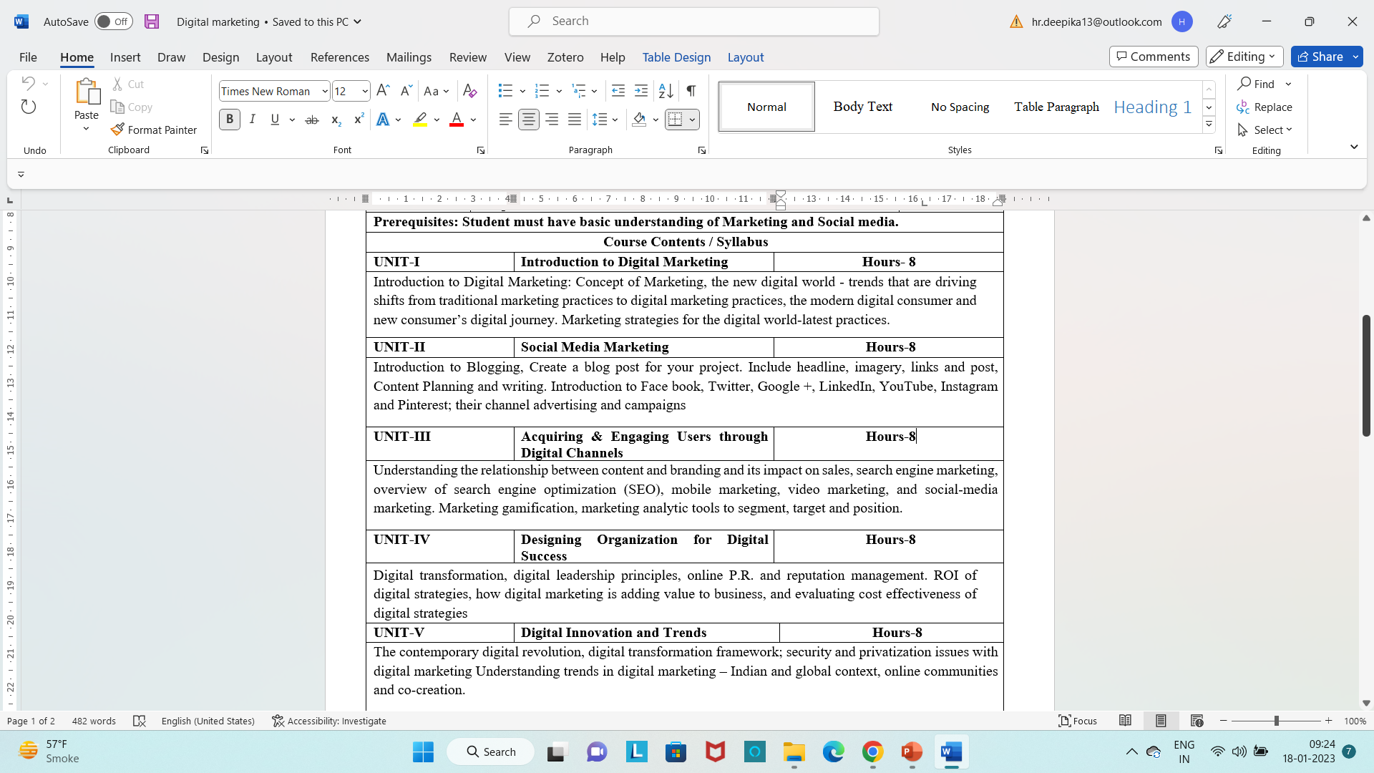
Syllabus

Slide 8
Applications in MBA
With the advent of new technologies, the field of Marketing has seen a paradigm shift over the years.
Though it is still in use, businesses across the world have switched from traditional modes of marketing to digital marketing.
This, in turn, has created many new opportunities for companies to expand their business and has created tremendous employment opportunities across sectors.
From Content curation and management to Social Media Marketing and Brand Management, a career in Digital Marketing can take you in several directions.
Top Job Profiles: Digital Marketing Manager, Social Media Manager, Content Writer

Slide 9
Course Objectives
1 | Provide understanding of digital and social media marketing practices.
2 | Provide understanding of the concept of social media platforms
3 | Impart learning on various digital channels and how to acquire and engage consumers online.
4 | Provide insights on building organizational competency by way of digital marketing practices and cost considerations.
5 | Develop understanding of the latest digital practices for marketing and promotion.

Slide 10
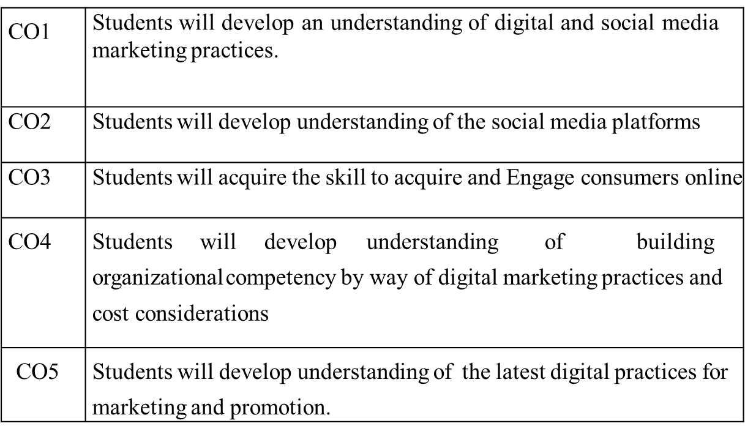
Course Outcomes

Slide 11
Program Outcomes
PO1: Knowledge of Management theories and practices
PO2: Analytical & Critical thinking abilities
PO3: Value based leadership
PO4: Understand, analyze and communicate all aspects of business
PO5: Achievement of Organizational goals

Slide 12
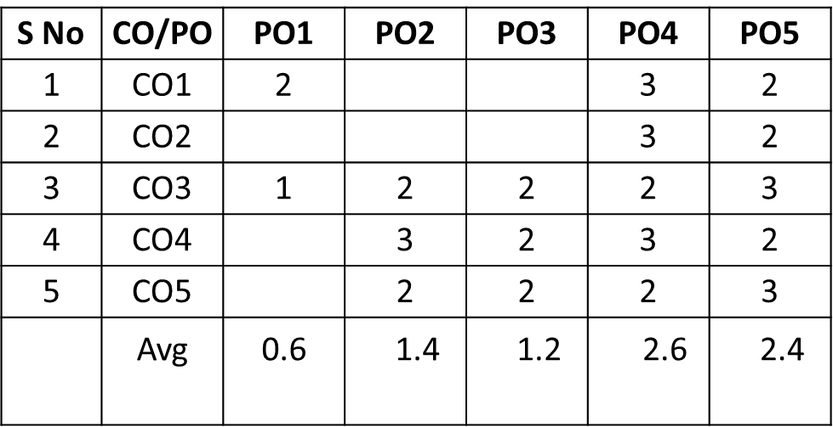
CO-PO Mapping
High=3,Medium =2 ,Low=1

Slide 13
Program Educational Objectives
PEO1: Conceptual Knowledge to adapt in rapidly changing environment and learn new skills and demonstrate application of management principles in professional work setting.
PEO2: Apply appropriate tools for decision making for solving complex managerial problems in local or global context.
PEO3: Exhibit Integrity, social responsibility and teamwork.
PEO4: Exhibit ethics, communication skills, leadership qualities and entrepreneurial mindset.

Slide 14
Result Analysis

Slide 15
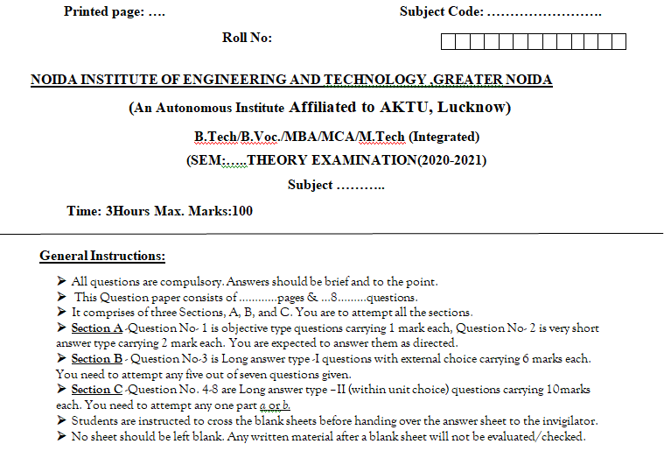
End Semester Question Paper Template

Slide 16
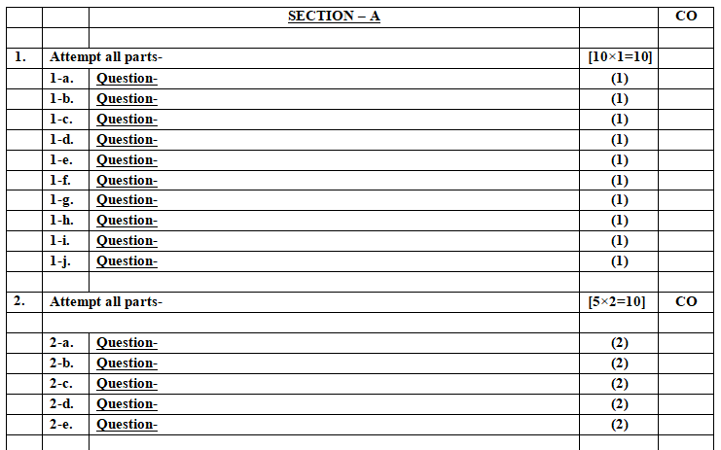
End Semester Question Paper Template

Slide 17
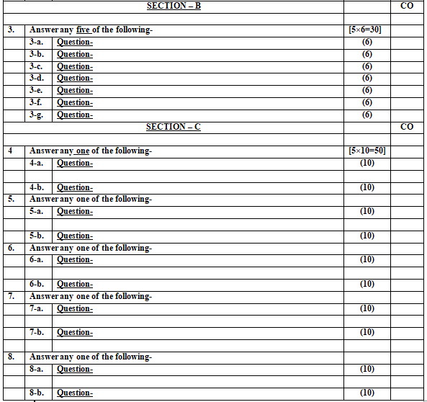
End Semester Question Paper Template

Slide 18
Prerequisite and Recap
Pre-requisites: Understanding of Basics of marketing concepts and social media platforms

Slide 19
Introduction of the subject
The course is designed to make learner conversant with Digital Marketing and proficient in Social Media tools and techniques starting from the fundamentals of digital marketing.
Social media websites and applications allow users to create and exchange user-generated content where people talk, share information, participate and network through technologies such as blogs and social networking sites.
Within the last decade, social media has become one of the most powerful sources for news updates, online collaboration, networking, viral marketing and entertainment.
https://www.youtube.com/watch?v=Xuq6_udbeH0&list=PLi3oNa09iwJRByiNwEJNaZ3XVKcveovzk
https://www.youtube.com/watch?v=X-pCbWwu50k

Slide 20
Unit Contents
Introduction to Digital Marketing (CO1)
Concept of Marketing(CO1)
The new digital world - digital marketing practices(CO1)
The modern digital consumer (CO1)
New consumer’s digital journey(CO1)
Marketing strategies for the digital world-latest practices. (CO1)

Slide 21
Objectives of the Unit
To make the students understand the Digital marketing trends.
To understand the new digital world.
To make the students aware of different types of digital customers.

Slide 22

Noida Institute of Engineering and Technology, Greater Noida
(Unit –I) Topic 1
Introduction to Digital Marketing

Slide 23
Session Objectives
1. To develop a general understanding on Digital Marketing among the students.
2. To help students gain insights as to why digital marketing is gaining so much importance .
3. To enable students understand the shift from traditional to digital marketing.

Slide 24
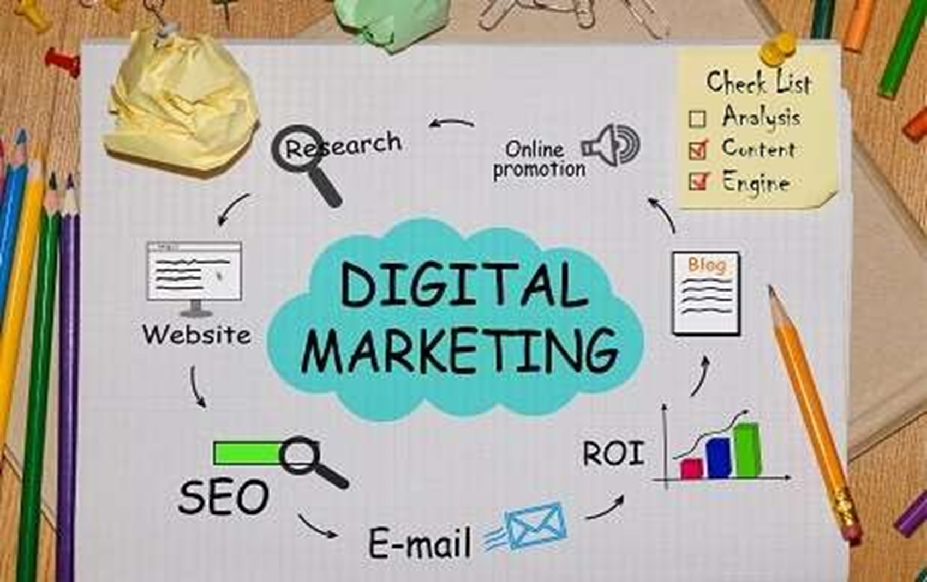
Digital Marketing(CO1)

Slide 25
Digital Marketing(CO1)
Digital marketing is the marketing of products or services using digital technologies, mainly on the Internet, but also including mobile phones, display advertising, and any other digital medium.
In fact, digital marketing now extends to non-Internet channels that provide digital media, such as mobile phones (SMS-Short Message Service and MMS- Multimedia Messaging Service.), callback, and on-hold mobile ring tones.
Notes:
In essence, this extension to non-Internet channels helps to differentiate digital marketing from online marketing, another catch-all term for the marketing methods mentioned above, which strictly occur online.

Slide 26
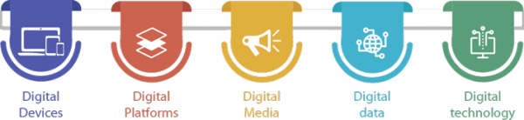
The 5Ds of digital marketing(CO1)
Notes:
1. Digital devices
This device helps the audiences to interact with the brands through various digital methods.
The various digital devices include:
Mobile phones
Laptops,
Gaming devices
Television.
These devices help customers to stay connected with brands constantly.
2. Digital platform
A browser works as a medium that helps to create interactions between brands and customers.
Among digital platforms, social media is the largest and it has users more than half of the world population. Reports say that social media receive 950,000 new users each day.
Applications and browsers digital platforms include:
Google
YouTube
Twitter
LinkedIn
Facebook
3. Digital media
This refers to paid, and owned communications channels which helps to build engagement with the target market using several ways includes,
Advertising emails
Messaging
Search engines
Social networks.
4. Digital data
This consists of customers profiles and engagement patterns with businesses. Collect data about consumers, which gives u the insight on their interest, and curate their buying decisions for promoting. This data is used for cross-selling, Improving user experience, and increasing customers buying rate. This analysis also helps to promote new products and its use cases.
Here are some of the ways to collect this data digitally such as:
Website contacts form
POS
Contests
Surveys,
Event sign-ups
App installation
5. Digital technology
These are electronic tools, systems, devices and resources that help to generate, store or process data. For example, artificial intelligence, cloud computing, virtual reality, big data and Internet of Things. It focuses on building interactive experiences across various platforms.
Artificial Intelligence helps businesses to collect more data about their audience. Then, they use these data to offer:
Predictive search
Chatbots
Recommendation engines

Slide 27
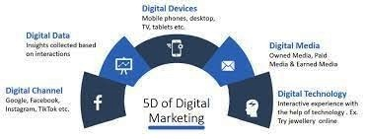
The 5Ds of digital marketing(CO1)
Notes:
1. Digital devices
This device helps the audiences to interact with the brands through various digital methods.
The various digital devices include:
Mobile phones
Laptops,
Gaming devices
Television.
These devices help customers to stay connected with brands constantly.
2. Digital platform
A browser works as a medium that helps to create interactions between brands and customers.
Among digital platforms, social media is the largest and it has users more than half of the world population. Reports say that social media receive 950,000 new users each day.
Applications and browsers digital platforms include:
Google
YouTube
Twitter
LinkedIn
Facebook
3. Digital media
This refers to paid, and owned communications channels which helps to build engagement with the target market using several ways includes,
Advertising emails
Messaging
Search engines
Social networks.
4. Digital data
This consists of customers profiles and engagement patterns with businesses. Collect data about consumers, which gives u the insight on their interest, and curate their buying decisions for promoting. This data is used for cross-selling, Improving user experience, and increasing customers buying rate. This analysis also helps to promote new products and its use cases.
Here are some of the ways to collect this data digitally such as:
Website contacts form
POS
Contests
Surveys,
Event sign-ups
App installation
5. Digital technology
These are electronic tools, systems, devices and resources that help to generate, store or process data. For example, artificial intelligence, cloud computing, virtual reality, big data and Internet of Things. It focuses on building interactive experiences across various platforms.
Artificial Intelligence helps businesses to collect more data about their audience. Then, they use these data to offer:
Predictive search
Chatbots
Recommendation engines

Slide 28
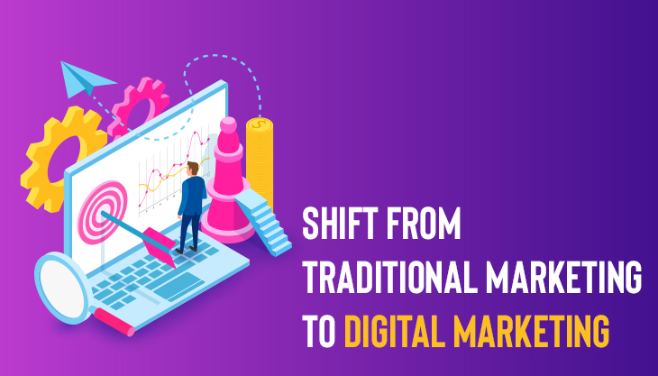
Why Are Businesses shifting from Traditional marketing to Digital Marketing? (CO1)

Slide 29

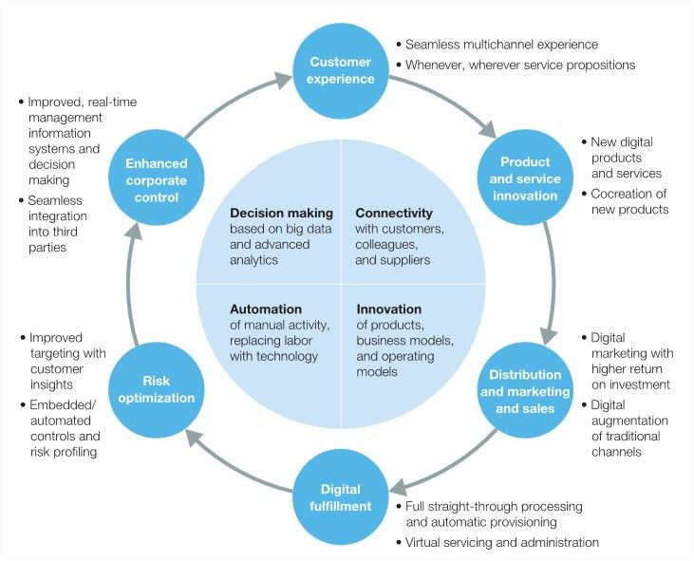
Why Are Businesses shifting from Traditional marketing to Digital Marketing? (CO1)

Slide 30
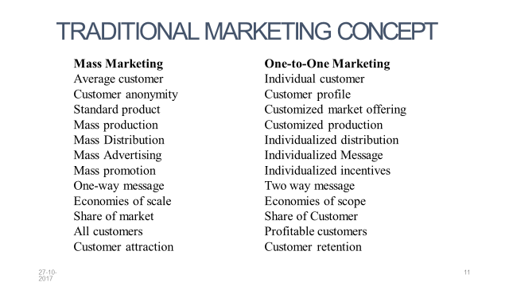
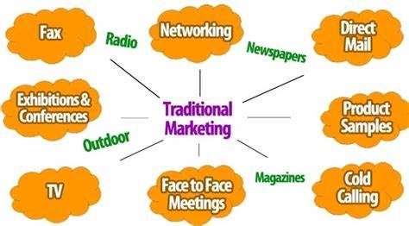
Traditional Marketing (CO1)

Slide 31
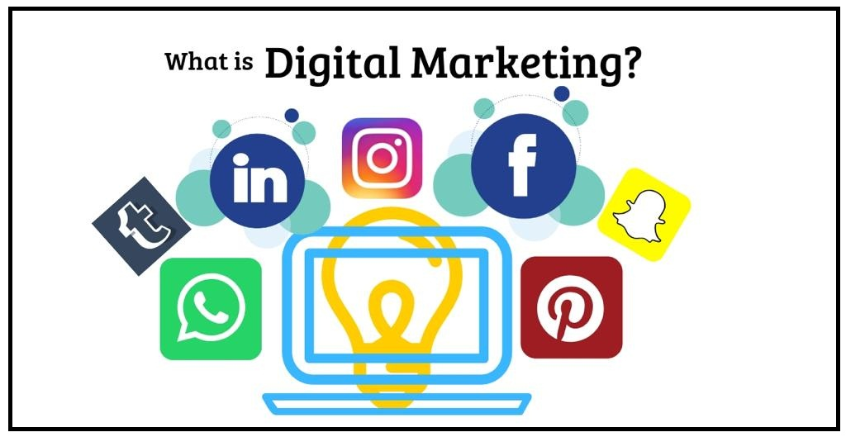
Digital Marketing (CO1)

Slide 32
Why Are Businesses shifting from Traditional marketing to Digital Marketing? (CO1)
Targeting-Digital marketing allows businesses to target a specific audience with specific demographics. It also allows for very personalized targeting. Traditional Marketing in turn, are not highly specific in its targeting.
It’s Good On The Pocket: Traditional Marketing such as print ads, broadcasting, etc. takes a great chunk out of your budget. As opposed to it, Digital marketing is rather cost friendly. You can build your website free on WordPress and SEO can get you organic i.e. not paid traffic to your website, which can get you customers who buy your products/services.
Find The World At Your Fingertips: Unlike Traditional Marketing which is restricted to a region or even nation, Digital Marketing gives you a global reach. You can market and promote your business to the global audience and market. Thus, you get a larger reach.

Slide 33
Why Are Businesses shifting from Traditional marketing to Digital Marketing? (CO1)
It Gives You The Proofs: Once you put in a newspaper ad or TV ad or poster, you don’t really glean any information on how many people were inspired to buy your product/service by any specific Traditional Marketing Medium. Digital Marketing comes with tools which give all the data, analytics, and reports, on any one or more marketing campaigns you are running.
It Makes For A Two way Interaction: Traditional Marketing is a rather one way interaction. A advertisement on TV, radio, newspaper, etc. Digital Marketing however, allows for a two way interaction, so that the audience/reader can put in his/her opinions and even questions.

Slide 34
Some facts about Indian Digital Marketing Industry
(CO1)
As per a report by IAMAI (Internet and Mobile Association of India)and Boston consulting group, India has one of the largest and fastest growing populations of Internet users in the world—190 million as of June 2014 and growing rapidly.
According to a report, India will cross 500 million Internet Users Mark in 2022
According to Direct Marketing Association, Digital Marketing Industry is worth $62 billion
Reference: https://www.researchgate.net/publication/303163963_Digital_Marketing_in_Indian_Context

Slide 35
Some of the reasons why digital marketing is on the rise
(CO1)
(I) Converting the marketing to sales
(II) Interaction with customers
(III) Cost Friendly
(IV) Targeted Reach
(V) Fair Play

Slide 36
Daily Quiz
Define Digital marketing.
5 D’s of Digital Marketing are______
Which of the following is the correct depiction of Digital Marketing?
E-mail Marketing
Social Media Marketing
Web Marketing
All of the above
4. Which is a bigger concept : Selling or marketing?
5. Give 2 reasons for growing importance of Digital Marketing.

Slide 37
Noida Institute of Engineering and Technology, Greater Noida
(Unit –I) Topic 2
The new digital world - digital marketing practices

Slide 38
Recap
Digital marketing is the marketing of products or services using digital technologies, mainly on the Internet.
Digital importance is gaining impetus because of its wide & targeted reach, customer friendly and cost effective approach.

Slide 39
Session Objectives
1. To develop a general understanding on Trend change in Digital Marketing among the students.
2. To explain the Marketing Practices For The digital World

Slide 40
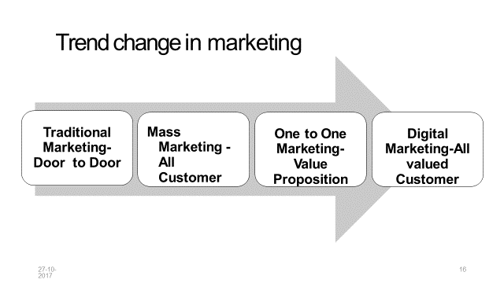
Trend Change in Marketing (CO1)

Slide 41
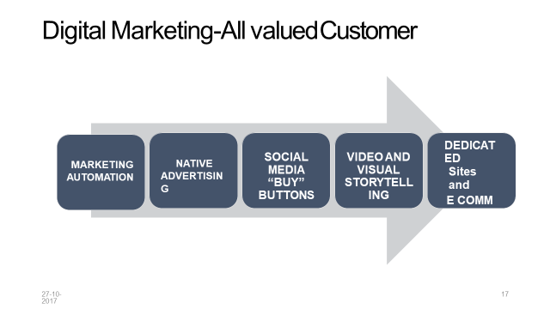
Marketing Practices For The Digital World(CO1)

Slide 42
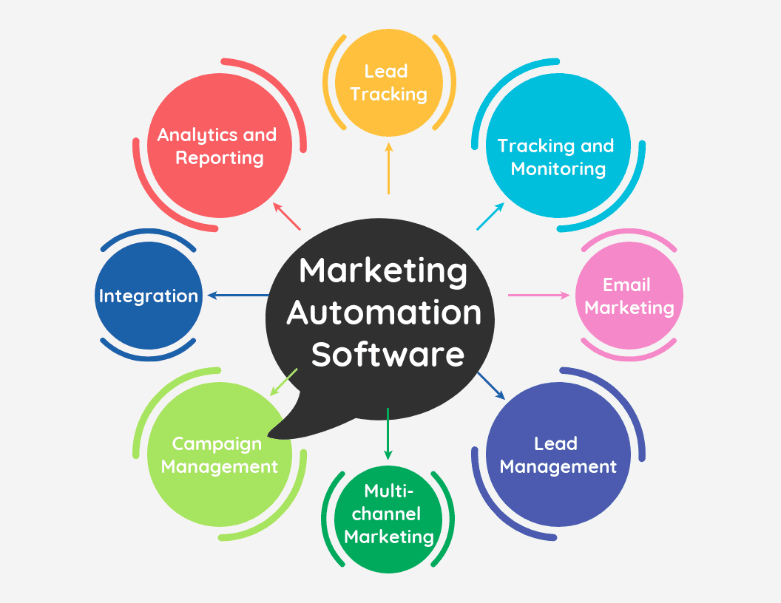
Marketing Practices For The Digital World(CO1)
1. Marketing Automation

Slide 43
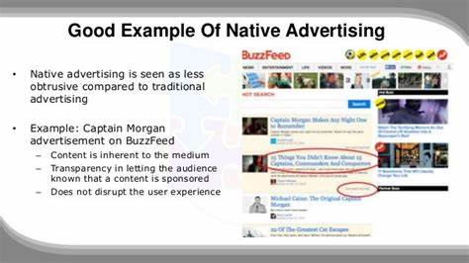
Native Advertising in Digital World(CO1)
Native ads often feature as recommended content on websites, appearing below or beside the article you just read. They also appear as “in feed” ads, as part of your news feed on social networks, such as Facebook or Twitter. Another form that native ads take is search and promoted listings that appear at the top of your Google search results, or in the sidebar.

Slide 44
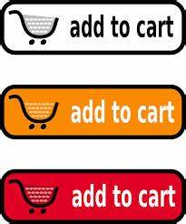
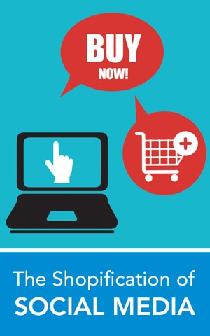
Social Media Buy Button in Digital World(CO1)
Social media “buy buttons” came on the scene in 2014 and were thought to be the next big thing in social media marketing. They provided a new way for retailers to sell directly to consumers.

Slide 45
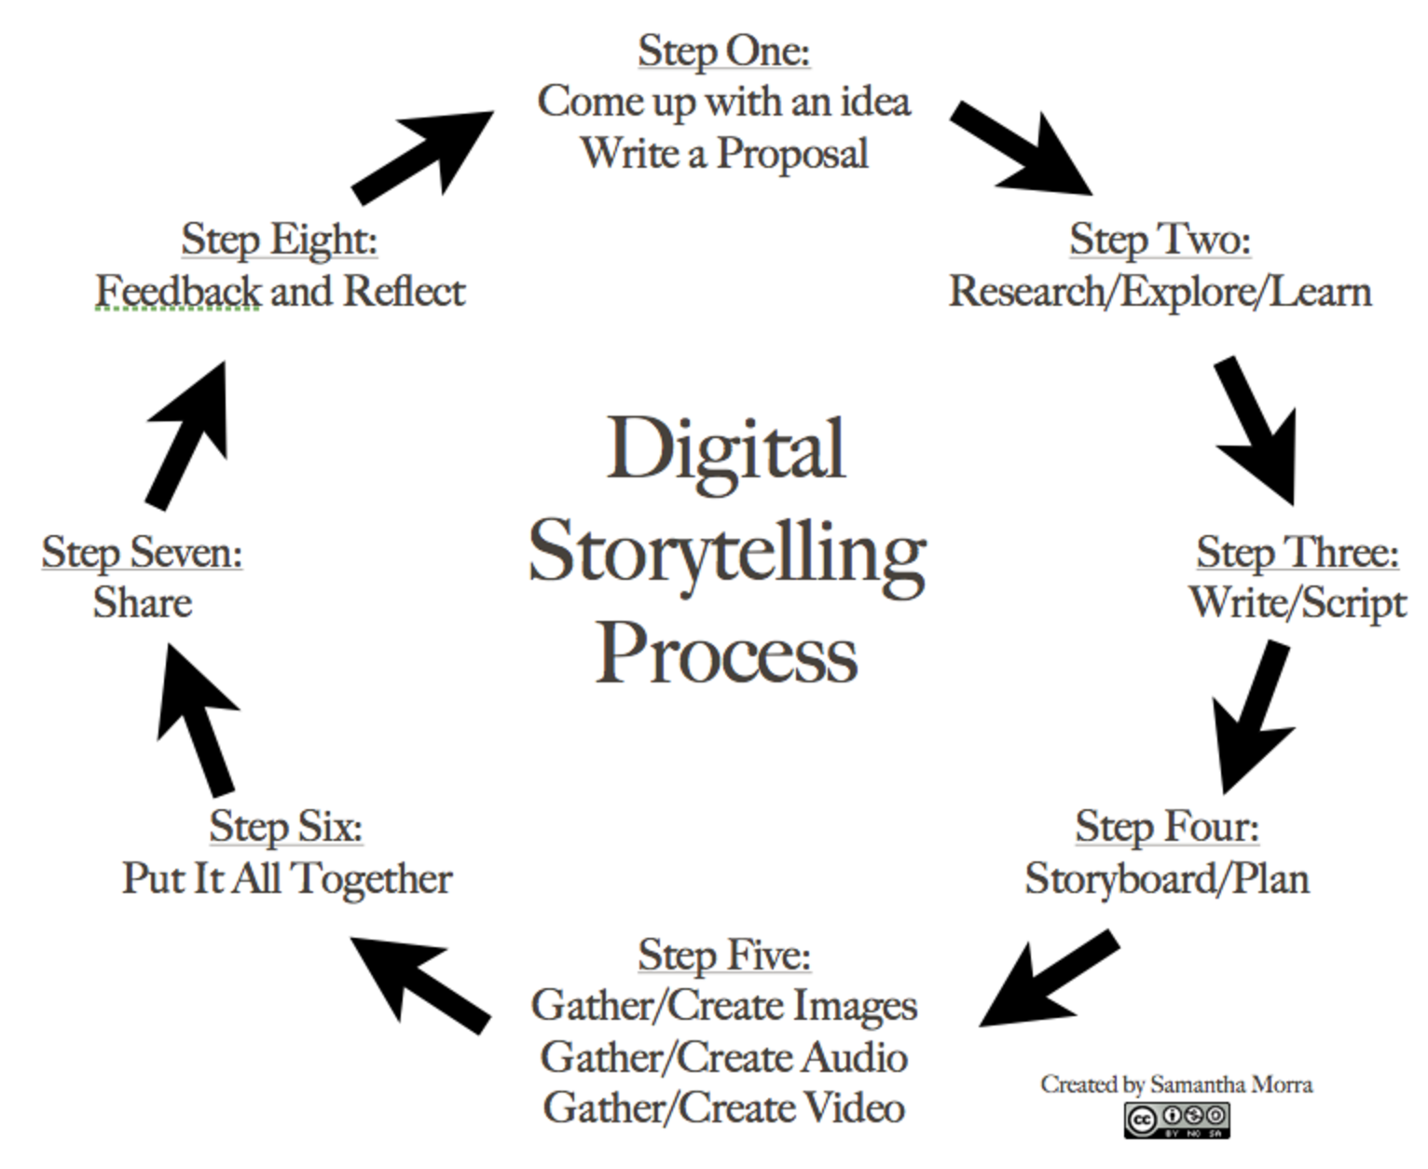
Video and Visual Storytelling in Digital World(CO1)
Visual storytelling uses graphics, images, videos and more to hook the audience and drive storylines and emotions. It’s quite literally the act of telling a story or communicating information with visual content — and it’s an insanely powerful content marketing medium.

Slide 46
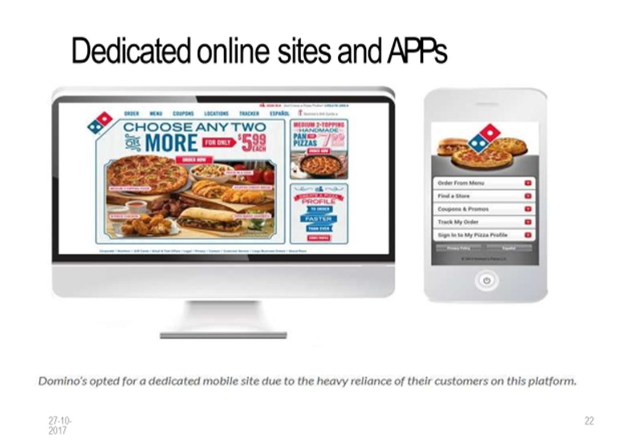
Dedicated Online Sites and Apps in Digital World(CO1)

Slide 47
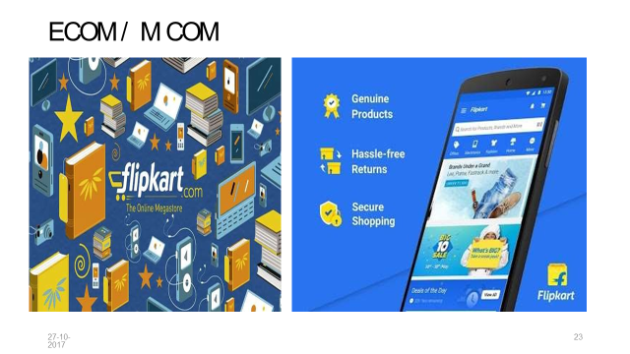
E-Com Sites in Digital World(CO1)

Slide 48
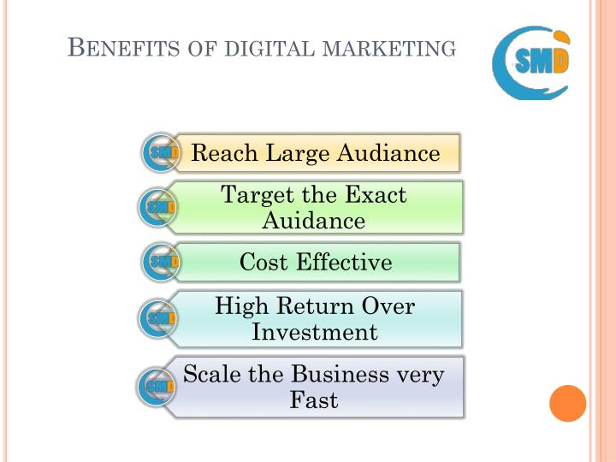
Digital Marketing Advantages (CO1)

Slide 49
Daily Quiz
Name any 2 marketing strategies for the digital world.
Define Marketing Automation.
_______ is the use of paid ads that match the look, feel and function of the media format in which they appear.
Dedicated online sites are ______.
E-com stands for _________.

Slide 50
Noida Institute of Engineering and Technology, Greater Noida
(Unit –I) Topic 3
The modern digital consumer and its digital journey

Slide 51
Recap
Marketing Practices For The Digital World are:
Marketing Automation
Native marketing
Social media ‘buy buttons’
Video/ Visual story telling
Dedicated sites and apps
E-commerce

Slide 52
Session Objectives
1. To discuss the digital consumer journey
2. To make the students aware about different types of Digital customers.

Slide 53
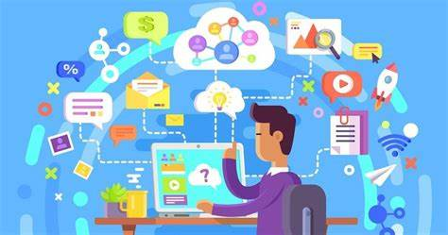
Digital consumer (CO1)
A digital consumer may be defined as someone using mobile devices, and in a broad sense, as e-consumer, looking for and purchasing products on the Internet, taking advantage of the content published on-line, aware of themselves and of their needs, and keen on simplifying the decisions they need to make.
Notes:
In some cases, the digital customer journey can extend beyond the act of purchase or subscription; to customer loyalty. For example, the brand may offer personalized post-sale offers or adapted content to improve the buyer’s knowledge and experience of their newly purchased product.

Slide 54
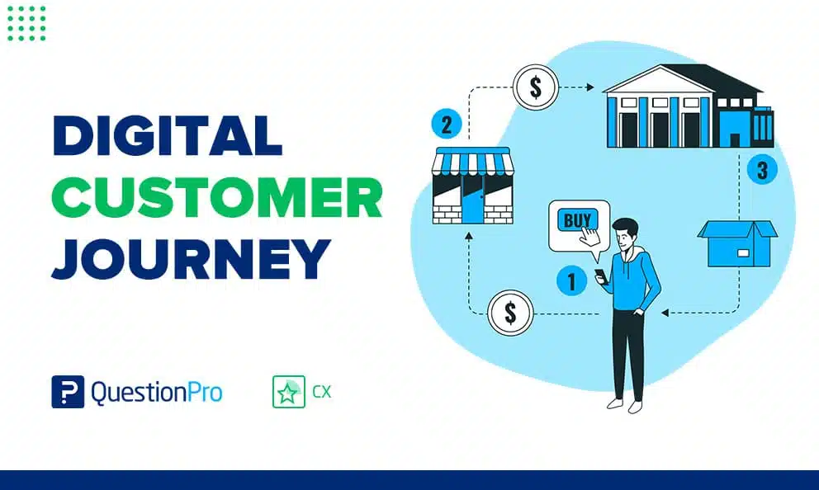
Digital consumer journey (CO1)
The digital customer journey is the path an online user takes to find your business. It’s a journey that’s made up of every single interaction a customer has with your company, from social media to your actual website.
The Digital Customer journey (DCJ) is the process carried out by a user. It goes from the moment the user identifies they have a need, to the moment they acquire a product or service to satisfy or solve it.
Notes:
In some cases, the digital customer journey can extend beyond the act of purchase or subscription; to customer loyalty. For example, the brand may offer personalized post-sale offers or adapted content to improve the buyer’s knowledge and experience of their newly purchased product.

Slide 55
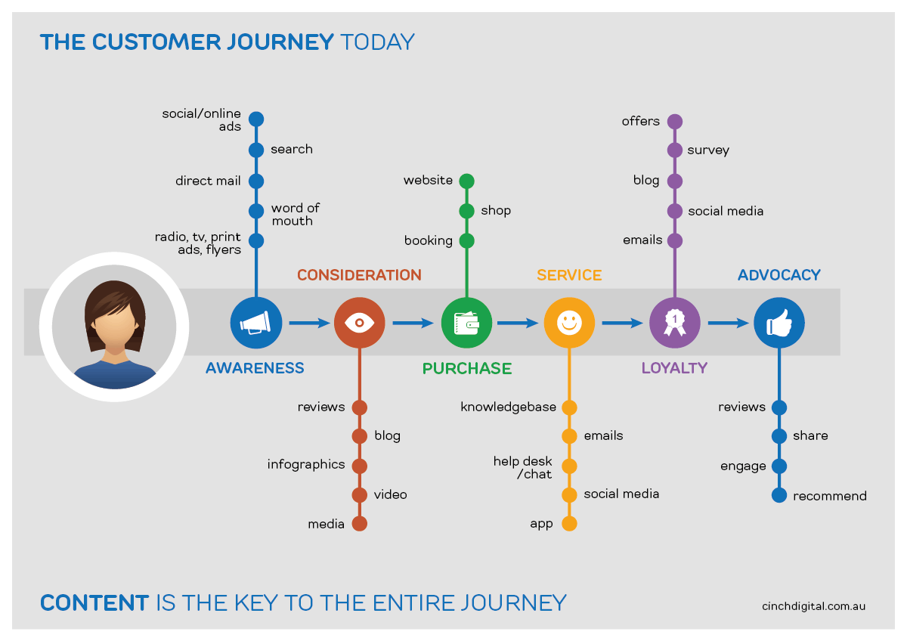
Stages of Digital consumer journey (CO1)
https://bignerdranch.com/blog/the-5-steps-of-the-digital-customer-journey/

Slide 56
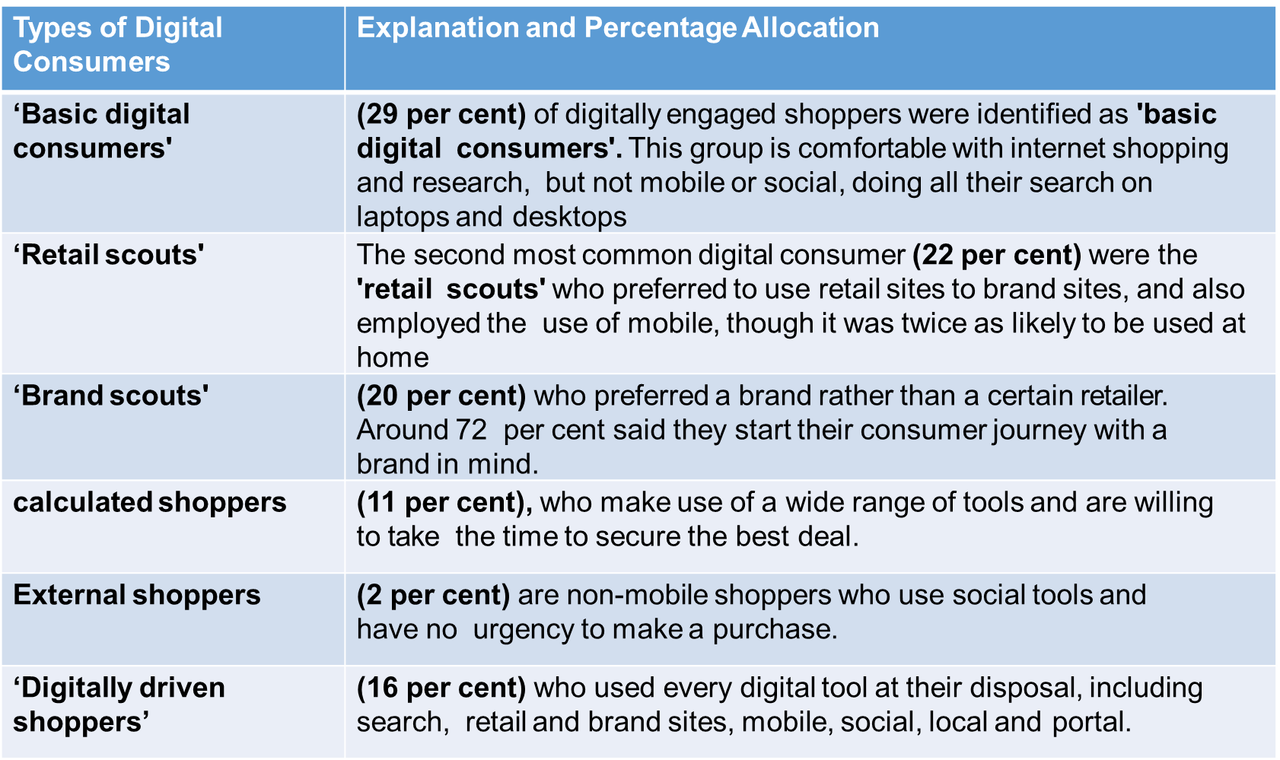
Digital Customers (CO1)

Slide 57
Daily Quiz (CO1)
______ are customers who prefer a certain brand rather than a retailer.
Eternal shoppers make use a wide variety of tools to secure the best deal. (True/False)
The discovery stage when your customer realizes they need something is known as _____.
In this stage, the customer will determine if what was expected is what they received and determine if they are satisfied.
Awareness b. Consideration
c. Fulfillment d. Experience

Slide 58
Noida Institute of Engineering and Technology, Greater Noida
(Unit –I) Topic 4
Marketing strategies for the digital world-latest practices.

Slide 59
Recap
The digital customer journey is the path an online user takes to find your business. It’s a journey that’s made up of every single interaction a customer has with your company, from social media to your actual website.

Slide 60
Session Objectives
1. To explain the different Marketing strategies For The digital World.

Slide 61
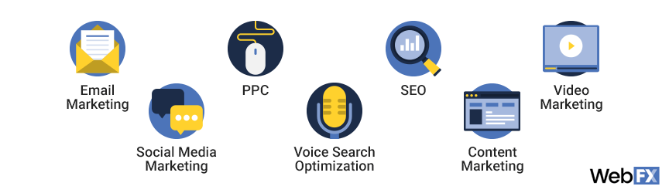
Marketing Strategies For The Digital World(CO1)

Slide 62
Marketing Strategies For The Digital World(CO1)
Search engine optimization (SEO): SEO is the process of improving your website so that it ranks highly in search engine results for keywords and phrases related to your business.
Pay-per-click (PPC) : PPC is a paid form of advertising that relies on an auction-based system. With PPC, you bid on keywords that you want your ads to show up for — your ad triggers when a user’s search includes your keyword. These ads then appear at the top of search results, above organic listings.
Content marketing:In content marketing, your business focuses on reaching, engaging, and connecting with consumers via content. This content, which can include videos, blog posts, infographics, and more, provides values to users.
Email marketing:Email marketing focuses on retaining existing customers, as well as gaining new ones. It’s an excellent technique for building brand awareness, keeping your company top-of-mind, and encouraging repeat purchases.

Slide 63
Marketing Strategies For The Digital World(CO1)
5. Social media marketing: Social media marketing focuses on building brand awareness and increasing conversions. A social media marketing campaign can feature one or several social media platforms, depending on your target audience and their platform preferences.
6. Voice search optimization: With voice search optimization, your company optimizes existing and new website content for voice search. The intention is to earn your website the featured snippet or position zero spot in Google search results.
7. Video marketing : Via video marketing, your company increases its reach, grows its revenue, and expands its operations. Like content marketing, as well as email marketing, your business focuses on creating informational and valuable videos for its target audience.

Slide 64
Developing a Digital Marketing Strategy (CO1)
Set a goal
Find out your target audience
Describe your client’s profile
Identify effective marketing channels

Slide 65
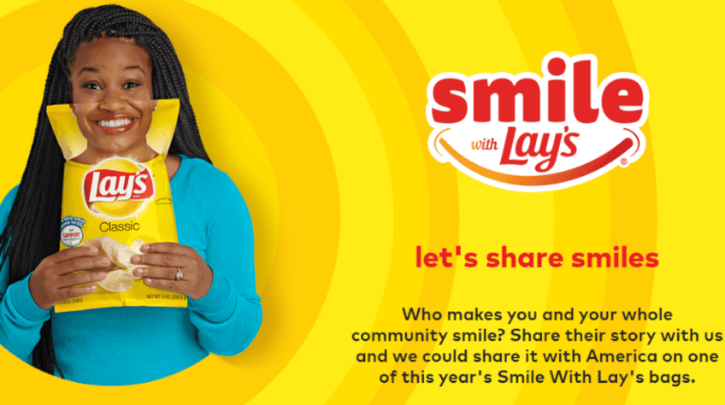
Case study for Digital Marketing Strategy(CO1)

Slide 66
Case study for Digital Marketing Strategy(CO1)
Lay’s is a potato chips company. It is an offshoot of the PepsiCo holding.
The essence of the unique #SmileDekeDekho ad campaign was a simple smile.
350 influential and popular personalities from all over the world were selected to promote the company.
They became the brand ambassadors and the faces of the advertising campaign.

Slide 67
Case study for Digital Marketing Strategy(CO1)
Why this marketing strategy was successful.
Snapchat and Instagram users took photos with a packet of chips and thus attracted new customers.
Good mood after purchase.
A pack of chips was associated with a smile and a positive mood for consumers.

Slide 68
Daily Quiz
1. This is the process of marketing accomplished or facilitated through the application of electronic devices, appliances, tools, techniques, technologies and or systems:
A. Direct Marketing B. Interactive marketing C. Electronic marketing D. Internet marketing
2. Marketing strategy contains the steps you need to take towards achieving your goals. (True/False)
3. _______ is a good opportunity to promote a product or service on social network.
4. Marketing ________ are a set of tools for successfully implementing a marketing strategy

Slide 69
Noida Institute of Engineering and Technology, Greater Noida
(Unit –I) Topic 5
Marketing Mix and Integrated Marketing Mix

Slide 70
Recap
A marketing strategy refers to a business's overall game plan for reaching prospective consumers and turning them into customers of their products or services. A marketing strategy contains the company's value proposition, key brand messaging, data on target customer demographics, and other high-level elements.

Slide 71
Session Objectives
1. To make the students aware of the Online marketing mix
2. To explain the different strategies for Integrated marketing Communication

Slide 72
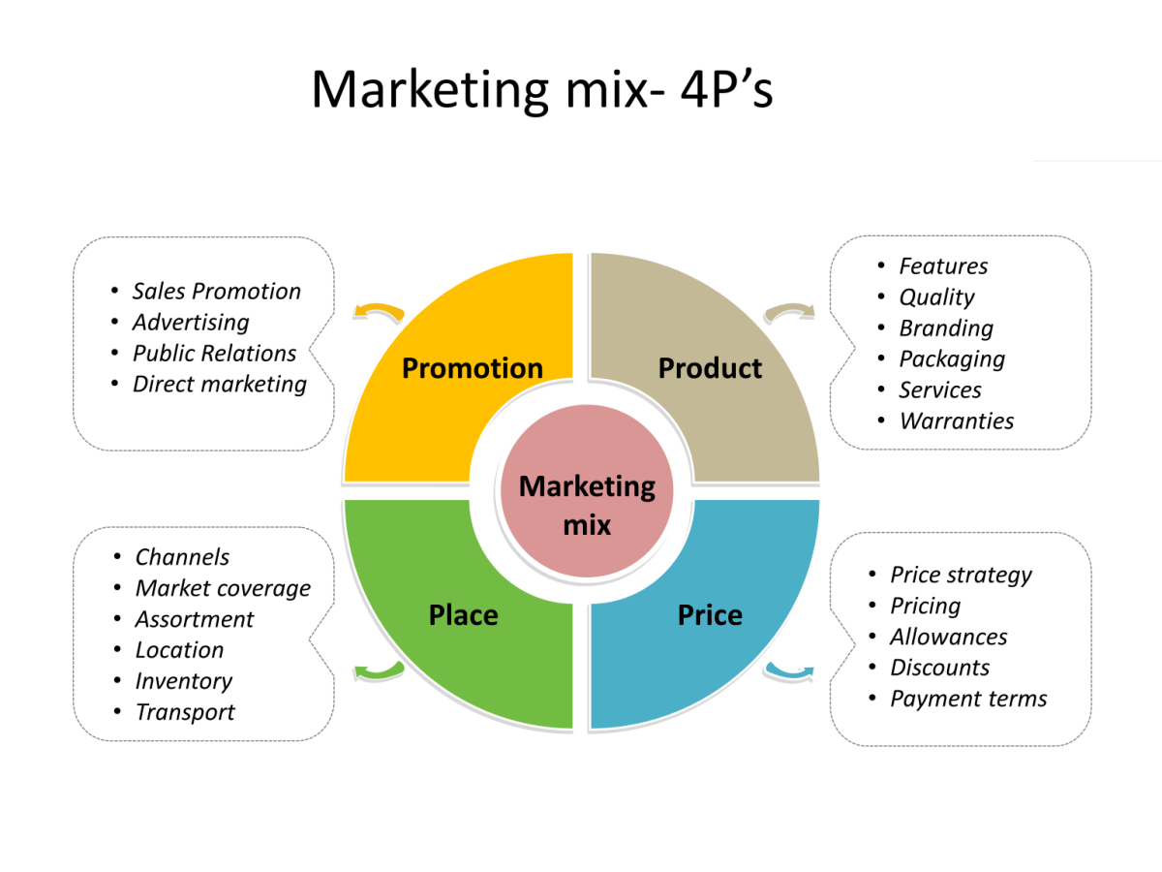
Marketing Mix (CO1)

Slide 73
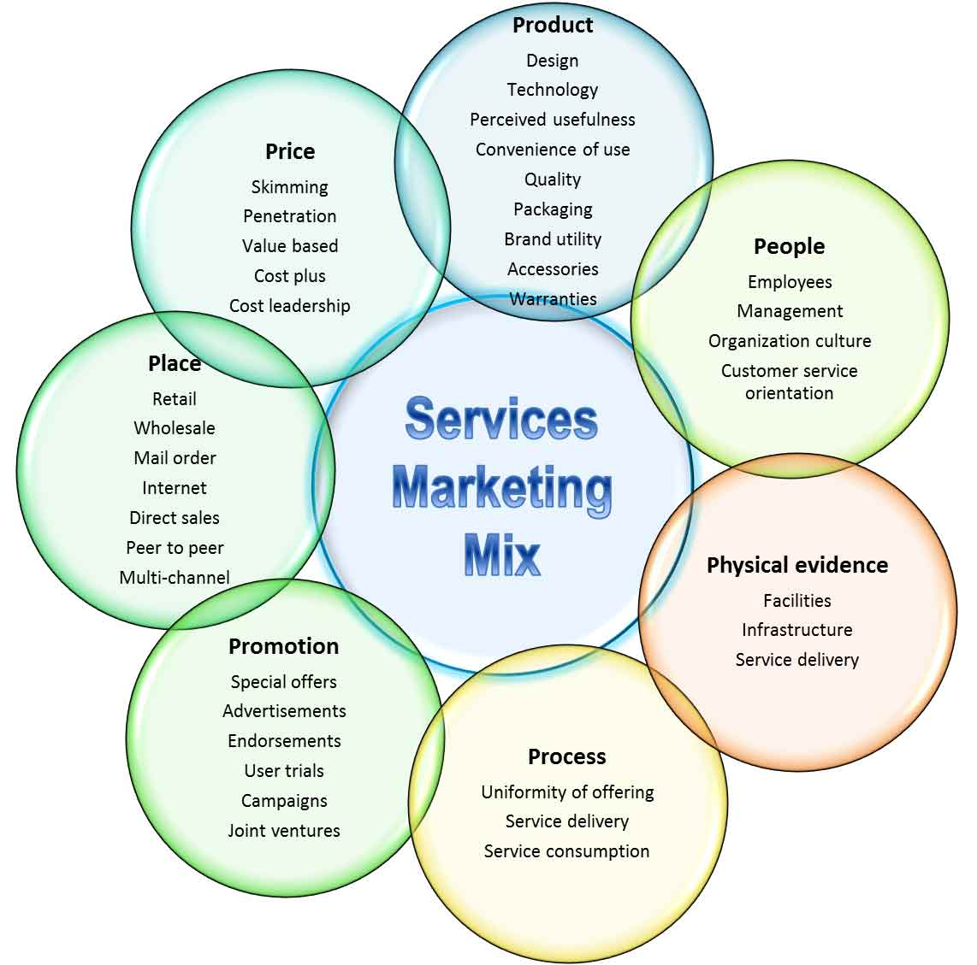
Service Marketing Mix (CO1)

Slide 74
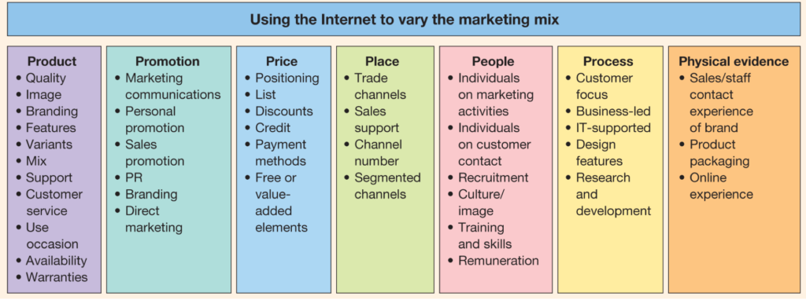
Online Marketing Mix (CO1)

Slide 75
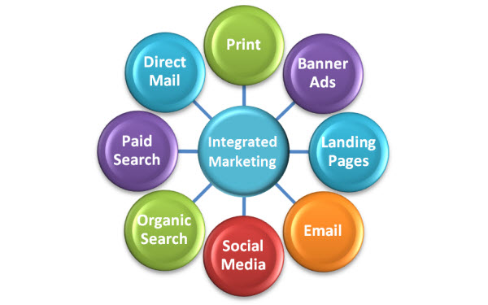
Integrated Marketing Communication (CO1)

Slide 76
Daily Quiz
Marketing Mix refers to _________.
3 additional P’s of Service marketing are _______.
_________________is an approach used by organizations to brand and coordinate their communication efforts.
4. ________ refers to the tangible and intangible elements that comprise the environment in which services are delivered.
5. Customer satisfaction for services consumption is based upon the quality of interactions with the personnel who provide the service. (True/False)

Slide 77
Assignment
1 | Discuss the importance of Digital marketing in today’s world (with special reference to COVID times).
2 | Explain how do Digital Consumers make their purchase with appropriate examples.
3 | Develop an Online marketing mix for a business of your choice.

Slide 78
Topic Links and Online Courses Details
https://www.youtube.com/watch?v=aC-DwwgqG6A
https://www.youtube.com/watch?v=KlTTWj4wTqE
https://www.youtube.com/watch?v=lEF8yxSDejk
https://academy.hubspot.com/courses/digital-marketing
https://www.youtube.com/watch?v=ZVuHLPl69mM
https://www.youtube.com/watch?v=2ydz3DjkFS0&t=35s
https://www.youtube.com/watch?v=2ydz3DjkFS0&t=35s
https://www.udemy.com/courses/marketing/digital-marketing/
https://www.coursera.org/specializations/digital-marketing

Slide 79
MCQ s
1. What are some examples of digital marketing?
Social Media Marketing
Search Engine Marketing
Search Engine Optimization
All of the above
2. The term Digital Marketing was first used in the .............
1999s.
1990s
1980s.
1989s.
3. What is the best way to promote a business with social media?
Choose the Right Platforms
Encourage Engagement
Provide Value & Don’t Over-Promote
All of the above

Slide 80
MCQ s
4. What do you mean by Digital marketing?
Digital marketing is referred to as online marketing, web marketing, and internet marketing.
Analog Marketing
Shop
None of the above
5. Which one is the best way to promote a business online?
It offers a lot of helpful and free information.
To collect as many information as possible.
to advertise your company's product.
All of the above
6. ________ is an example of B to B service.
YouTube brand channel.
Google
Yahoo
None of the above

Slide 81
MCQs
7. The 4Ps of marketing as defined by Philip Kottler are:
Price, Product, Place, and Promotion
Price, Performance, Place, and Promotion
Price, Product, Place, and Positioning
PR, Product, Place, and Person
8. Which one of these statements is correct?
A. There is a slow decline in digital budgets with an average reduction of 10% in digital marketing budget. B. 98% of marketers affirm that offline and online marketing are merging C. Online marketing professionals are paid 50% less than marketing professionals. D. Around 25% of the global population is now on the Internet.

Slide 82
Glossary
Marketing automation, Digital platform, Native advertising, Viral marketing, Digital devices
_______ include smartphones, tablets, desktop computers, TVs and gaming devices.
_______ is the process of leveraging software to automate repetitive marketing tasks.
________ is a sales technique that involves organic or word-of-mouth information about a product or service to spread at an ever-increasing rate
_________is a browser or apps from the major platforms or services, that’s Facebook (and Instagram), Google (and YouTube), Twitter and LinkedIn.
5. _________ is the use of paid ads that match the look, feel and function of the media format in which they appear.

Slide 83
University paper Links
https://www.uptunotes.com/aktu-paper-digital-marketing-mammk04-2018-19/
http://www.aktuonline.com/papers/B.Tech-3-sem-digital-and-social-media-marketing-kmbmk03-2020.pdf
http://www.aktuonline.com/papers/B.Tech-3-sem-digital-marketing-rmbmk-03-2018-19.html

Slide 84
Sessional Question paper

Slide 85
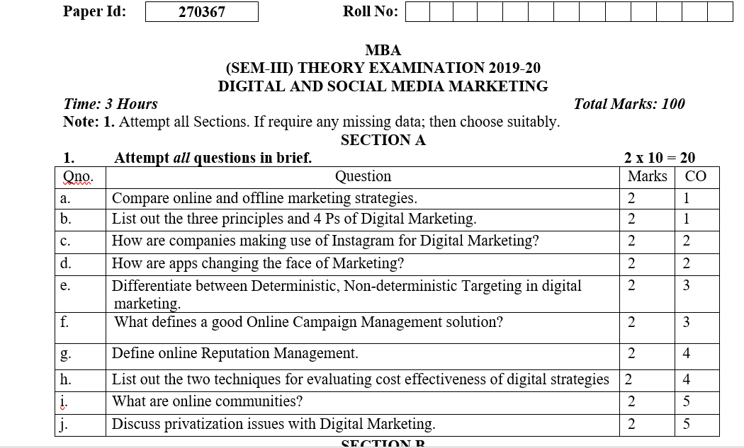
End Semester Question paper

Slide 86
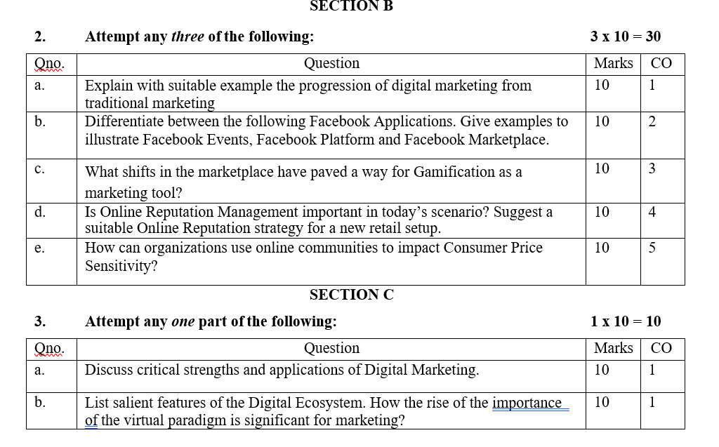
End Semester Question paper

Slide 87
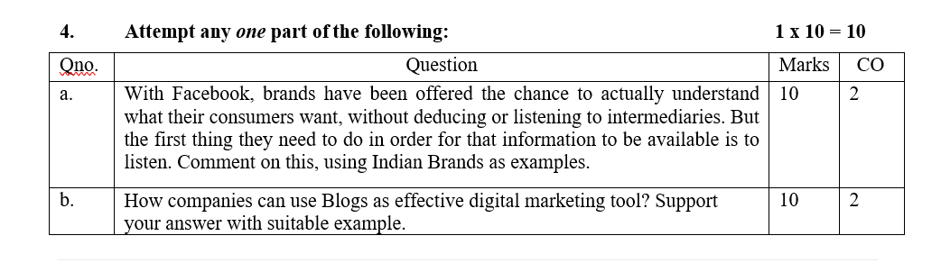
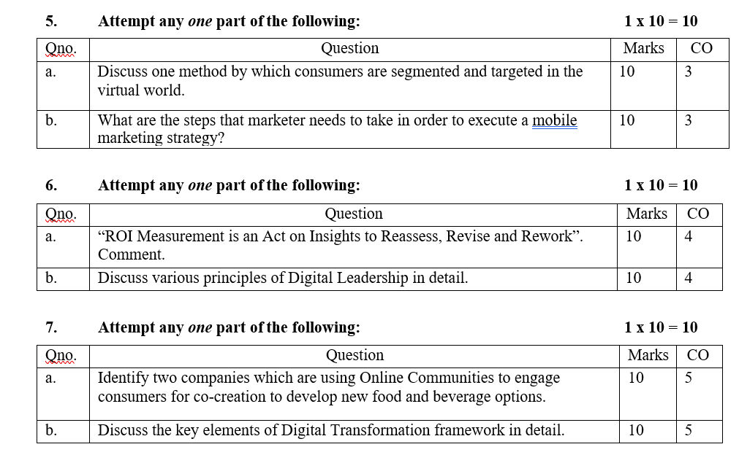
End Semester Question paper

Slide 88
Expected questions for University Exams
Q1.Explain what do you mean by term new digital world ? What are the key trends driving shift from tradition to digital marketing practices ?
Q2. Discuss the need for digital marketing in today’s digital world ?
Q3.Explain the 7 Ps of digital marketing in detail ?
Q4.Explain in detail the steps involved while crafting a digital marketing strategy ?
Q5.Throw light on the various market Strategies for the digital world.
Q6. Briefly discuss new digital paradigm changing the marketing world?
Q7. State the different types of Digital Marketing?
Q8. Name some useful Digital Marketing tools?
Q9. Explain PPC or Pay Per Click advertising?
Q10. State the limitations of Online Marketing.
Q11. Explain what do you know about Email Marketing.
Q12. Give reasons why Online marketing is preferred over Offline marketing.

Slide 89
Summary
Digital marketing is a subset of traditional marketing. It promotes your brand or products using digital channels such as the internet, emails and mobile phones, as opposed to more traditional media such as print, radio, TV or billboards. Finding new customers is the main aim of digital marketing. It has the advantage over traditional marketing techniques because online programs such as Google Analytics exist which enable you to analyze your marketing campaigns in real time. This is far faster than any non-digital technique.

Slide 90
References
https://www.equinetacademy.com/what-is-digital-marketing/
https://www.intelligenthq.com/the-six-types-of-digital-consumers/
https://engaiodigital.com/online-marketing-mix/
https://www.plerdy.com/blog/digital-marketing-strategy/
Moutsy Maiti: Internet Marketing, Oxford University Press India
Vandana, Ahuja; Digital Marketing, Oxford University Press India (November, 2015).
Ryan, Damian; Understanding Digital Marketing: marketing strategies for engaging the digital generation; Kogan Page (3rd Edition, 2014).
Tracy L. Tuten & Michael R. Solomon : Social Media Marketing (Sage Publication)

